Slide 1
Reaching Underserved Communities
Jenny Lee, Moderator, UF Center for Arts in Medicine
Panelists
Joe Taylor, Coordinator, Weems Arts in Medicine & Executive Director, Franklin’s Promise Coalition
Javier Rosado, Ph.D., Assistant Professor, FSU Medical Humanities & Clinical Psychologist, Collier Health Services

Slide 2
Identifying the Underserved
What is community?
Who are the underserved?
Where Are the Gaps?
How do we connect those in need with their resources?

Slide 3
What is Community?
Strategic planning
– and especially your Mission –
will help to define your scope & reach.
Notes:
Overwhelming to consider the amount of need in any given town or region. Not only do we need strong organizational plans, but every community collaboration needs a leader, and that leader needs a clear plan, vision and mission for the collaborative.

Slide 4
Underserved Communities
People: Who are the People in your Neighborhood?
Socioeconomic factors
Health status
Risk profiles
Cultural and ethnic makeup
Geographical location: Get Out the Map.
Neighborhoods
Travel Distance
Transportation
Connectivity: Connect the Dots.
Services and programs
Leadership – formal and informal authority
Levels of community engagement – existing structures
Resource: www.ncoengage.org
Notes:
Who are the underserved in your community?

Slide 5
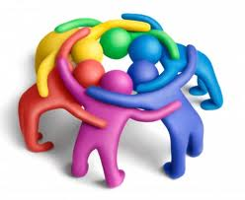
People
Who are the people in your neighborhood?
Notes:
How do you identify and access the many layers of the people across demographics: socioeconomic, health, culture, ethnic identity

Slide 6
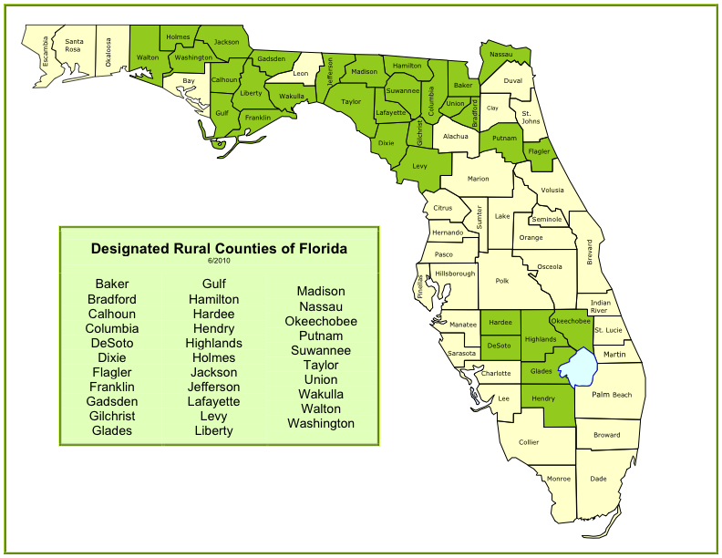
Geographic Region Get out the Map!
Notes:
Make use of the community resource map. How do you span the geographic space to distribute services and programs across a region equitably?

Slide 7
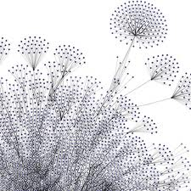
Connectivity
Connect the dots.
Notes:
What are some effective processes for connecting the dots across demographic and geographic distances?

Slide 8
Approaches to Locating Underserved Communities
Aggregate social indicators from existing data (needs assessment) such as: occupation, education, income, fertility rate, women who work, single family dwelling units, & ethnicity
Identify barriers to access (needs assessment)
Socioeconomic status
Geographic distance
Health status
Identify referral sources (community resource mapping); know who ‘knows’ – word of mouth, organizational referrals
Notes:
Discussion.

Slide 9
Think Big. Start Small.
Community change is a complex process that requires time.
Effective change takes place primarily through relationships. Relationships take time.
Respect, support and encourage those being asked to change. (education, training, retreats, mentoring, incentives, etc)
Build bridges across disciplines.
Recognize that coordinating existing services may not be enough.
Social problems and needs are not distributed equally in geographic space; for example, county statistics may not reflect the needs in some underserved pockets within the county.
Resource: Oregon State University Family Policy Program www.familiesandwork.org
Notes:
Accept that change is a complex process that takes a long time. It is better to expect
and plan for this reality than to be surprised and frustrated by it. Incorporate specific
strategies (e.g. training, retreats, mentoring, incentives, etc.) to support and encourage those
being asked to change. Lasting change takes place primarily through relationships.
Relationships take time to develop.
Build bridges across disciplines. Recognize that coordinating existing services may not be enough.

